Slide 1
Unit 12 Chapter 16
MONOPOLISTIC COMPETITION
Competitive market with price making behaviour
Imperfectly competitive market
Free entry and exit
Large number of sellers for the same group of customers
Product differentiation

Slide 2
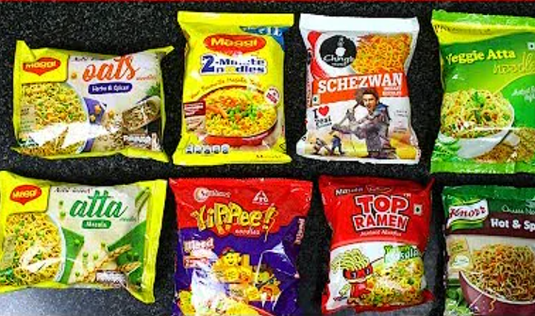

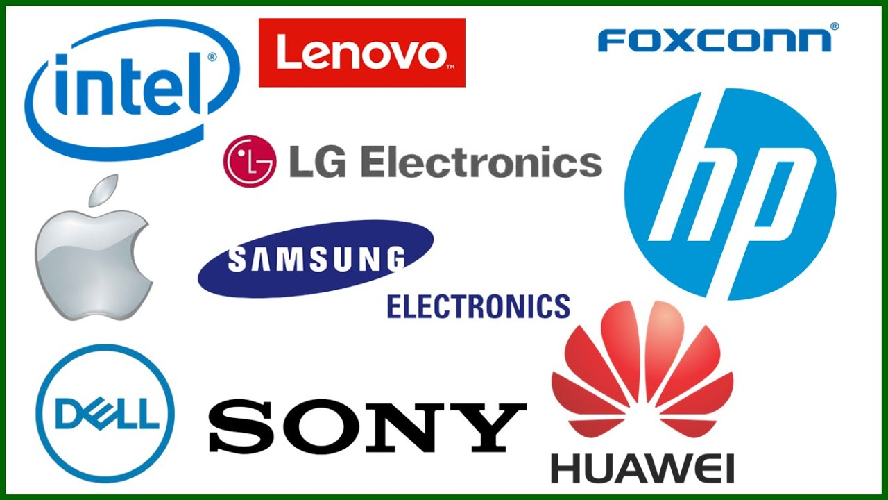

Slide 3


Market for books
Seemingly competitive
Yet monopolistic in nature
Market for movies
Seemingly competitive
Yet monopolistic in nature
One book or one movie is different from the other

Slide 4
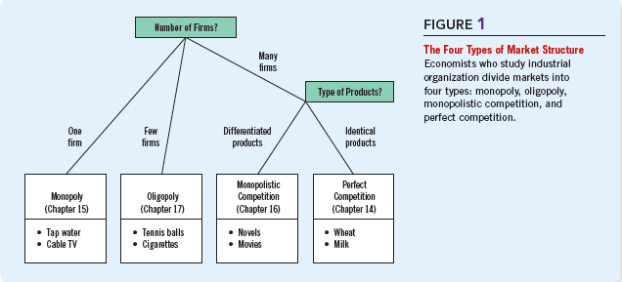
BETWEEN MONOPOLY AND COMPETITION
Each firm has a monopoly over the product it makes
Many other firms produce similar goods that compete for same customers

Slide 5
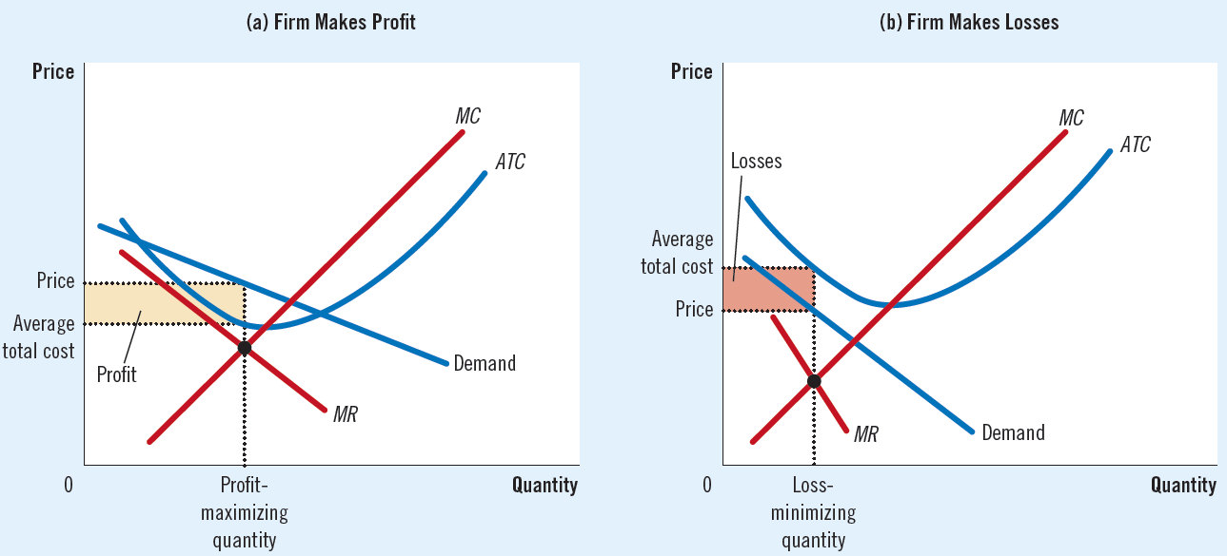
COMPETITION WITH DIFFERENTIATED PRODUCTS: short run equilibrium
Similar demand curve as a monopoly
Profit maximization at Q that equals MR and MC

Slide 6
COMPETITION WITH DIFFERENTIATED PRODUCTS: long run equilibrium
Short run profits attract new firms, shift the demand curve left and reduce profits
Short run losses leads to exit of existing firms, shift in the demand curve to the right and increase in profits
Entry and exit process continues until each firm earns zero economic profit
Tangency of AC with the demand curve to ensure per unit zero profit for firms
Tangency point equals the quantity of MR = MC
P > MC => monopoly nature
P = AC => competitive nature

Slide 7
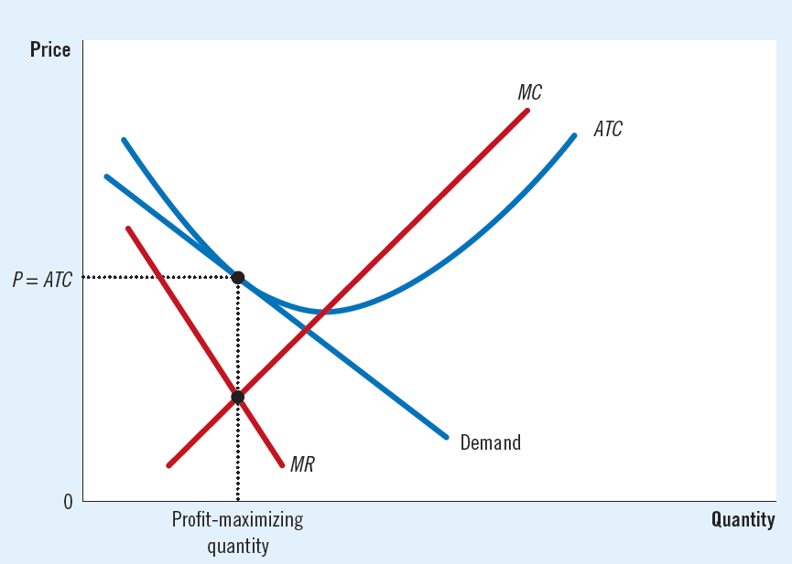
COMPETITION WITH DIFFERENTIATED PRODUCTS: long run equilibrium

Slide 8
COMPETITION WITH DIFFERENTIATED PRODUCTS: long run equilibrium

Slide 9
COMPETITION WITH DIFFERENTIATED PRODUCTS: long run equilibrium

Slide 10
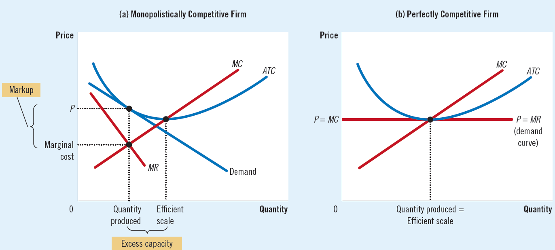
COMPETITION WITH DIFFERENTIATED PRODUCTS: comparing with competitive firms
Excess capacity
Price markup; P > MC

Slide 11
COMPETITION WITH DIFFERENTIATED PRODUCTS: welfare implications
Inefficient compared to competitive outcomes
Price markup deters some consumers from buying the product
Number of firms is either too many or too low
Externality: the uncompensated impact of one person’s actions on the well-being of a bystander
The product-variety (positive) externality
The business-stealing (negative) externality
Size of the externalities determines the nature of inefficiencies

Slide 12
ADVERTISING
Advertisements as a means of sale
Do advertisements manipulate people’s tastes and preferences?
Do advertisements provide misleading images on the products?
Are ads not useful in sharing information on the presence, price and sale of a product?
Advertisements signal the quality of the commodity
Brand names in advertisements to attract customers

